Slide 1

DIAMOND PRICE PREDICTOR
Submitted to: Submitted by:
Dr. Sarwan Singh Komal Yadav
Rajni
Archna

Slide 2
INDEX
Loading Data
Data Preprocessing
Algorithm used
Deployment

Slide 3
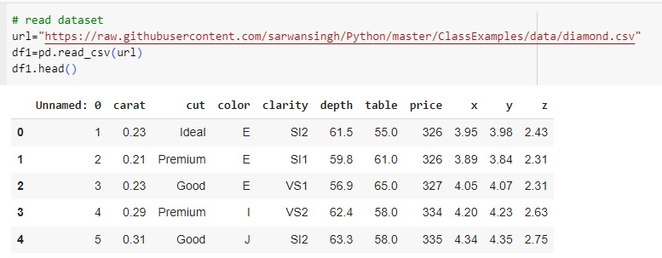
LOADING DATA
Dataset is taken from github.com
This dataset contains the prices and other attributes of almost 54,000 diamonds. There are 10 attributes included in the dataset including the target i.e. price.

Slide 4
Feature description:
price price in US dollars ($326--$18,823)This is the target column containing tags for the features.
The 4 Cs of Diamonds:-
carat (0.2--5.01) : Carat is the primary indicator of the size of a diamond.
cut (Fair, Good, Very Good, Premium, Ideal) : Cut determines the brilliance or sparkle of the diamond.
color, from J (worst) to D (best) : Color rating range from colorless to slightly tinted.
clarity (I1 (worst), SI2, SI1, VS2, VS1, VVS2, VVS1, IF (best)): The amount of inclusions or flaws in the diamond. Can range from flawless to included.

Slide 5
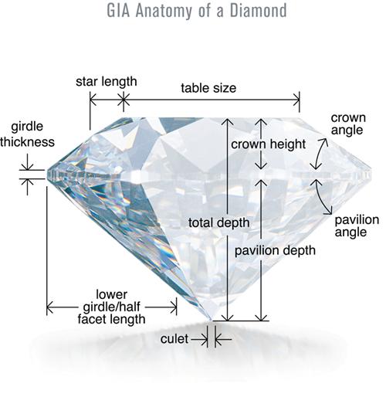
Dimensions:-
x length in mm (0--10.74)
y width in mm (0--58.9)
z depth in mm (0--31.8)
depth total depth percentage = z /mean(x,y) = 2 * z / (x + y) (43--79) The depth of the diamond is its height (in millimetres) measured from the culet (bottom tip) to the table (flat, top surface).
table width of the top of the diamond relative to widest point (43--95)
A diamond's table refers to the flat facet of the diamond seen when the stone is face up.
Dimensional Proportion of Diamond

Slide 6
DATA PREPROCESSING
Steps involved in Data Pre-processing
Data cleaning
Encoding categorical variables
Identifying and removing outliers

Slide 7

ALGORITHM USED
MODEL-Random Forest classifier
Model Deploy | Negative root mean error
Random Forest Classifier | -543.47
K-neighbors Classifier | -722.92
Decision Tree | -756.89
Linear Regression | -1215.30
XGB Regressor | -544.7

Slide 8
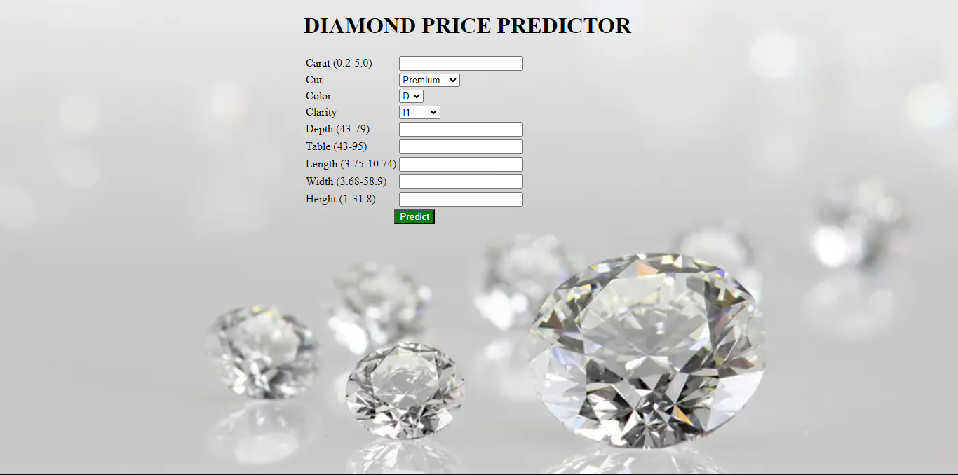
DEPLOYMENT

Slide 9
- THANK YOU -

